Slide 1
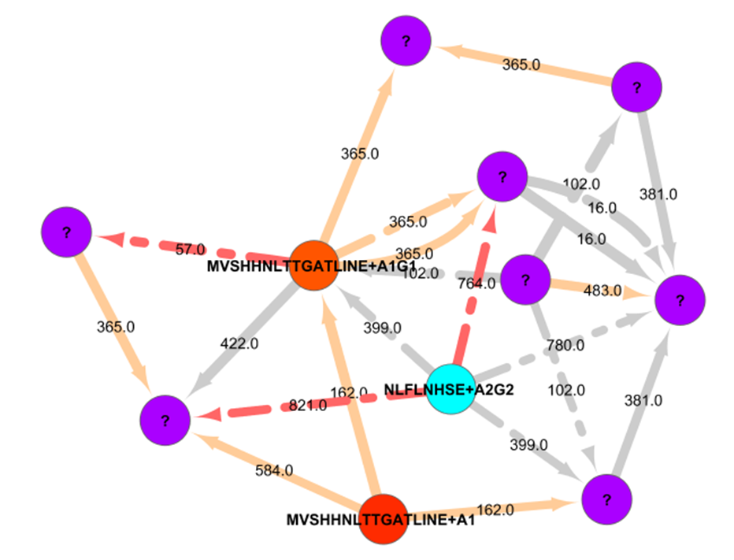
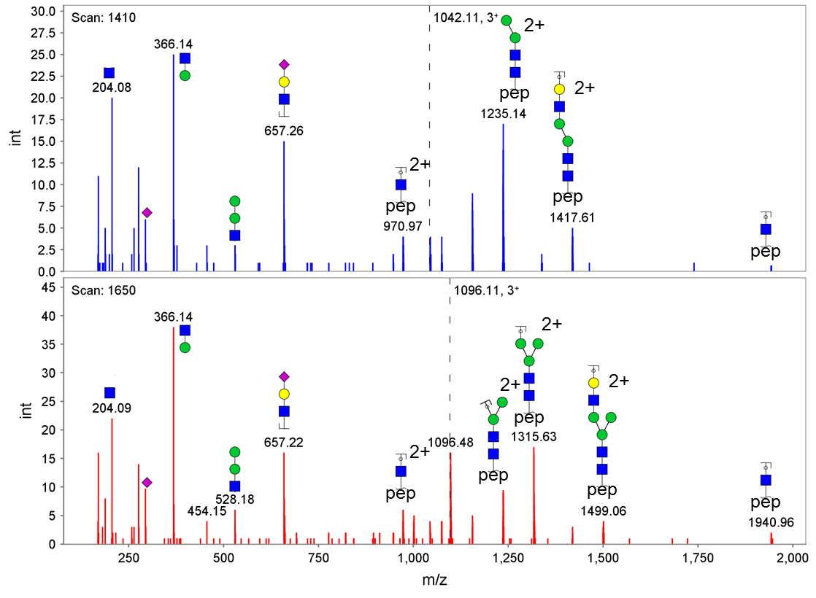
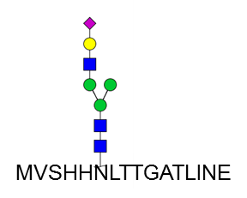
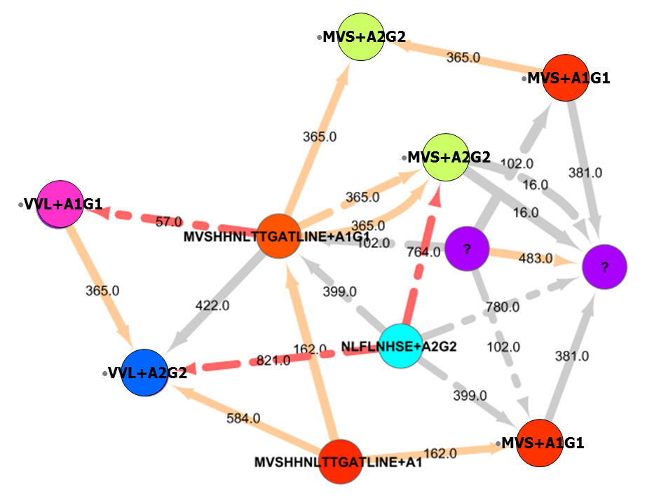
Characterization of N-glycan Microheterogeneity from CID Glycopeptide Fragmentation Mass-Spectra using Spectral Similarity Networks
Gwenn Berry, Sivan Leviyang, Radoslav Goldman, Nathan J. Edwards
Georgetown University, Washington, DC
Introduction
Network Propagation
Protein glycosylation is common and important, but challenging to characterize.
CID glycopeptide fragmentation spectra of simple glycoprotein mixtures can be identified using the GlycomeDB¹ glycan structure database and the GlycoPeptideSearch^{2,3} (GPS) software.
Unanimous voting algorithm:
Cleanup: Nodes’ neighbors vote on their glycopeptide assignment. Any node whose assignment disagrees with the majority of its neighbors’ votes is unlabeled. Any neighbor node in a dissenting minority is unlabeled. After cleanup, the entire network is in consensus with respect to assignments.
Iterative Propagation: Any unlabeled node with unanimously voting neighbors receives the corresponding glycopeptide assignment. The entire network remains in consensus after each round of propagation.
For the Haptoglobin Standard dataset:
Initial labels: 179 glycopeptide assignments
Final labels: 429 glycopeptide assignments (250 new, 5 changed)
Haptoglobin Standard Dataset
Proteolytic digest of Haptoglobin with trypsin and GluC
Hydrophilic interaction liquid chromatography (HILIC) of glycopeptides
Eleven glycopeptide fractions analyzed by nanoC18 RP LC-MS/MS using a Q-STAR Elite mass-spectrometer.
IDA: Four most abundant ions with 20 sec exclusion.
15,780 MS and 3,288 MS/MS spectra (msconvert to mzXML)
GlycoPeptideSearch
Automated in silico digestion and N-glycosylation motif identification.
Fixed & variable amino-acid modifications.
GlycomeDB glycan structure database.
Isotope Cluster match scoring of precursor.
False Discovery Rate (FDR) estimation using decoy peptides.
Result: 179 glycopeptide identifications on 4 peptides (< 3% FDR)
Spectral Similarity
Dot product based spectral similarity:
Precursor Δ < 1000 Da (Example spectra: 162 Da)
Eliminate peaks below 450 Da.
Traditional dot-product (e.g dot₀ = 0.557)
Best-peak-match dot-product vs 1+, 2+ shifted peaks only (e.g dot_{Δ} = 0.831)
Best-peak-match dot-product vs unshifted and 1+, 2+ shifted peaks (dot_{0,Δ} = 0.966)
Require dot₀ ≥ 0.3, dot_{Δ} ≥ 0.3, dot_{0,Δ} ≥ 0.5.
Spectral similarity network:
2,159 (of 3,288) spectra nodes and 74,731 spectral similarity edges.
References
Ranzinger, Herget, von der Lieth, Frank. Nucleic Acids Res. 39(Database issue) D373-376 (2011).
Pompach, Chandler, Lan, Edwards, Goldman. J. Proteome Res. 11(3) 1728-40 (2012).
Chandler, Pompach, Goldman, Edwards. J. Proteome Res. 12(8): 3652-66 (2013).
Acknowledgements
Gwenn Berry and Sivan Leviyang supported, in part, by NSF grant DMS-1225601. Radoslav Goldman supported by NCI R01 CA115625 and CA135069.

