Slide 1
Protein bioinformatics and systems biology
Nathan Edwards
Department of Biochemistry and
Molecular & Cellular Biology
Georgetown University Medical Center

Slide 2
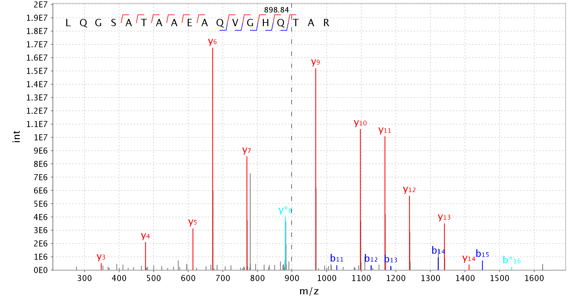
Unannotated Splice Isoform

Slide 3
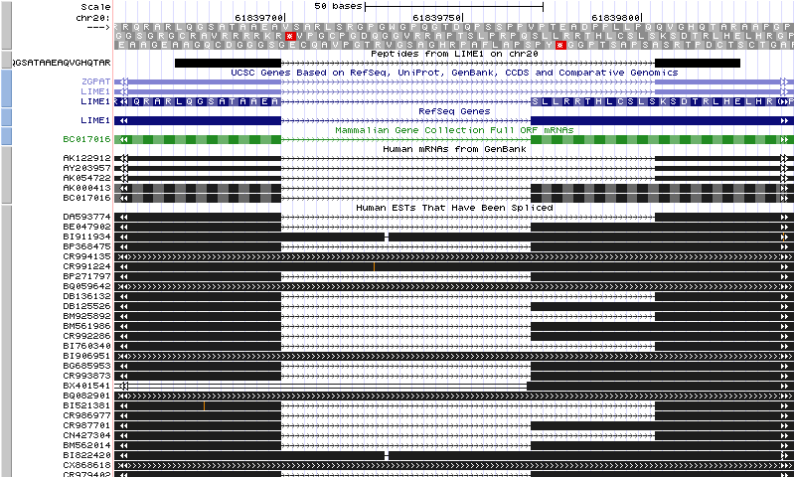
Unannotated Splice Isoform

Slide 4
Halobacterium sp. NRC-1
ORF: GdhA1
K-score E-value vs PepArML @ 10% FDR
Many peptides inconsistent with annotated translation start site of NP_279651

Slide 5
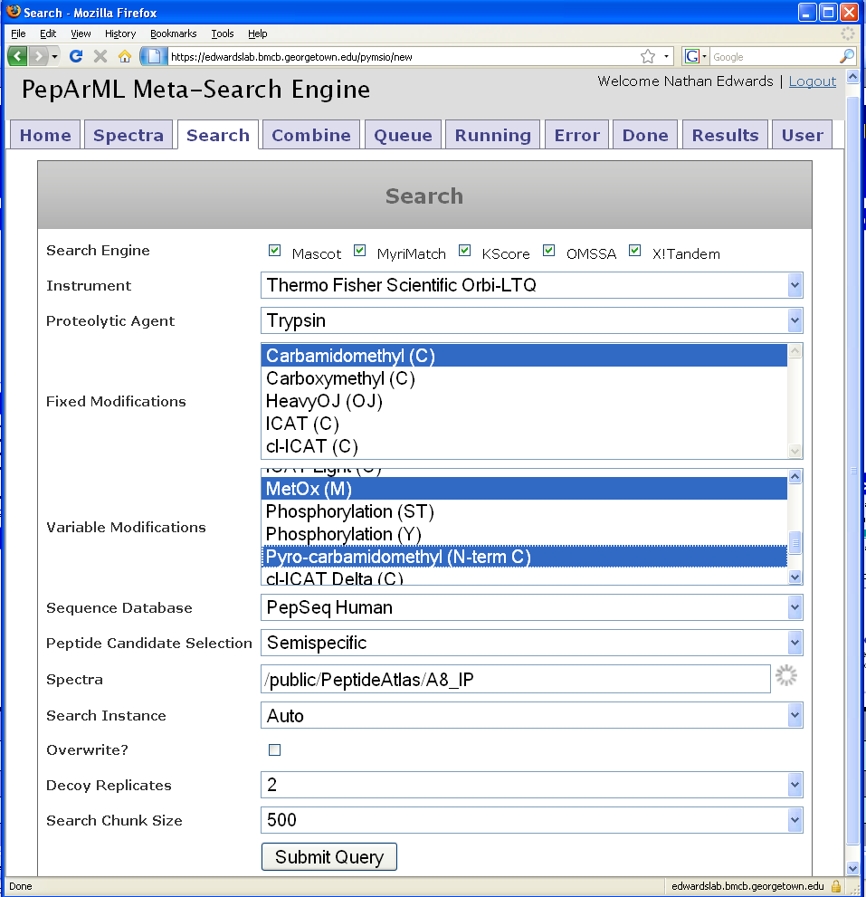

PepArML Meta-Search Engine
X!Tandem,
KScore,
OMSSA,
MyriMatch,
Mascot
(1 core).
NSF TeraGrid
1000+ CPUs
Heterogeneous
compute resources
X!Tandem,
KScore,
OMSSA,
MyriMatch.
Secure
communication
Edwards Lab
Scheduler &
80+ CPUs
Amazon AWS
Scales easily to
250+ simultaneous
searches
Single, simple
search request

Slide 6
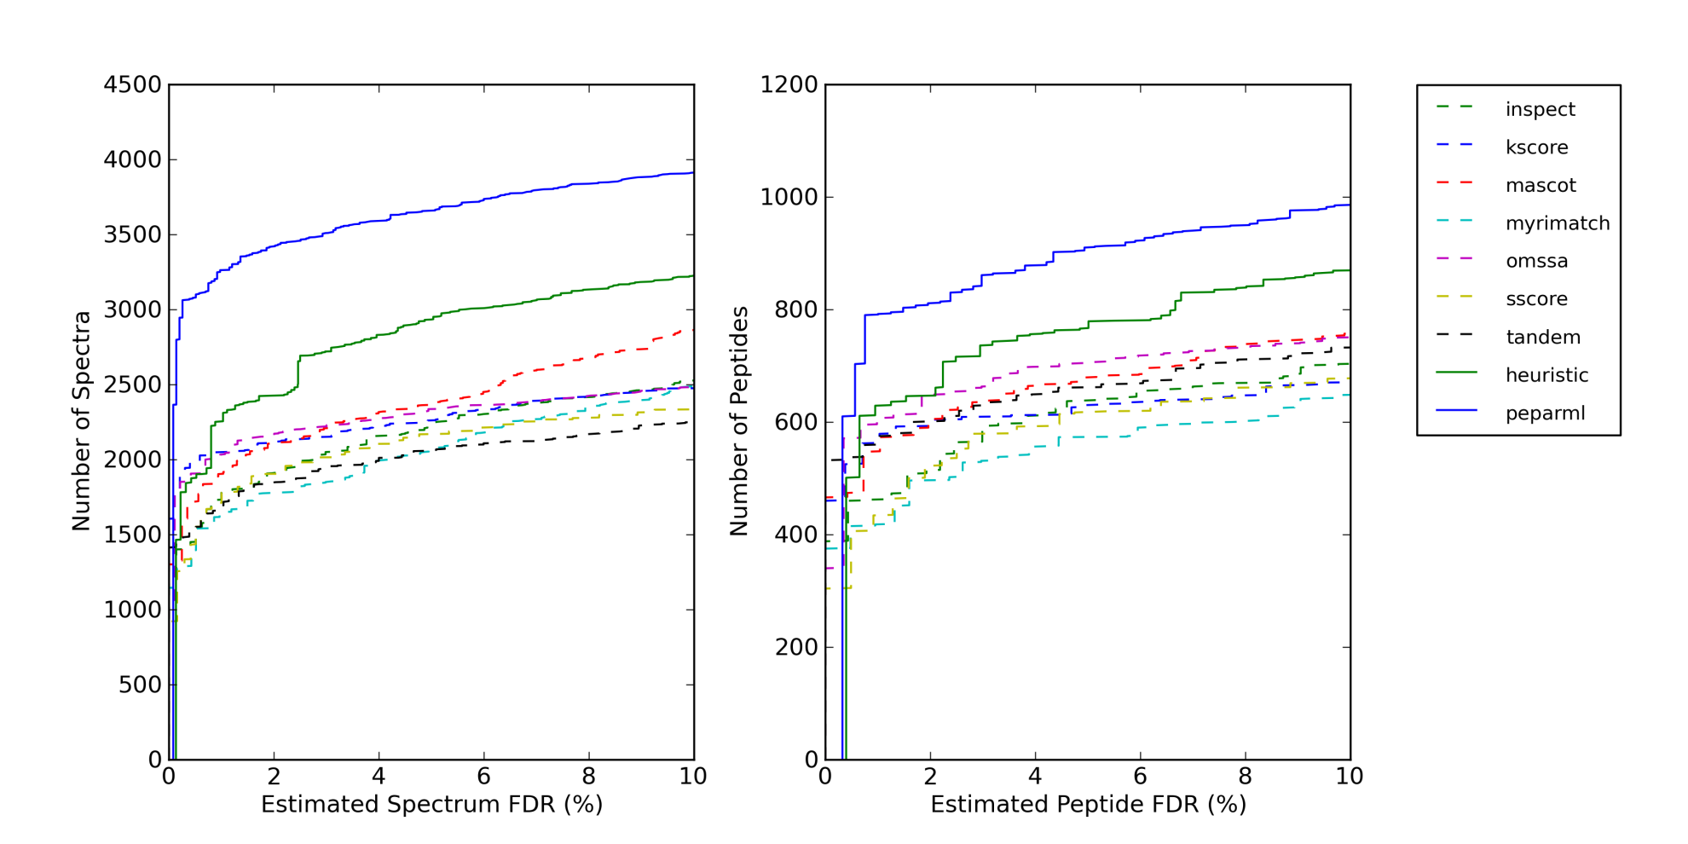
False-Discovery-Rate Curves

Slide 7
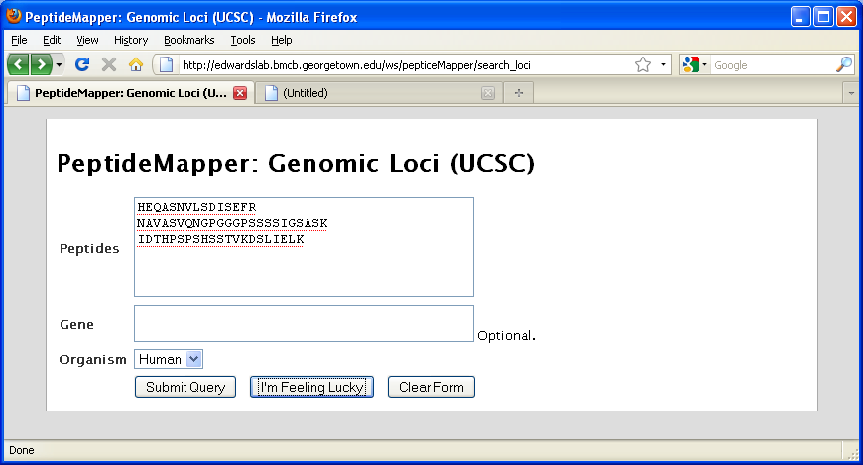
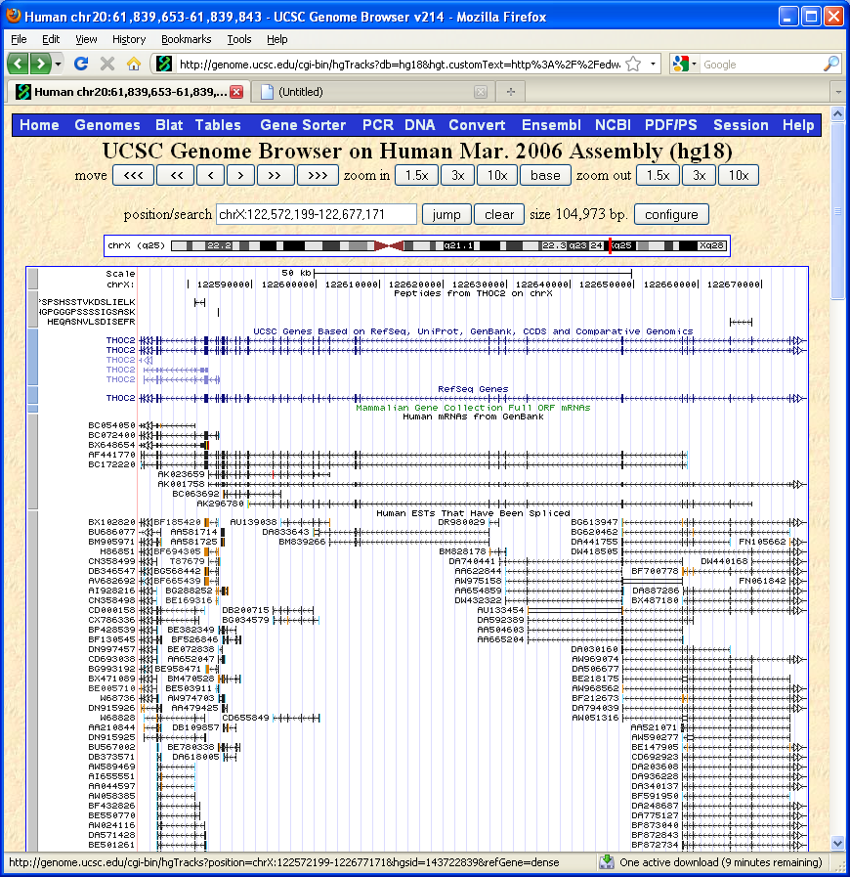
PeptideMapper Web Service
I’m Feeling Lucky

Slide 8
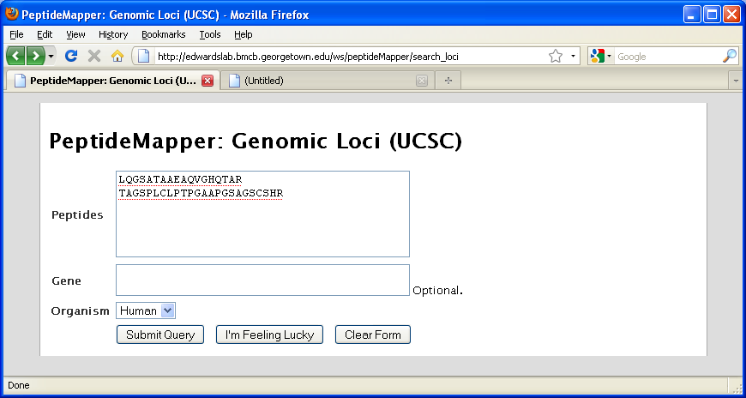
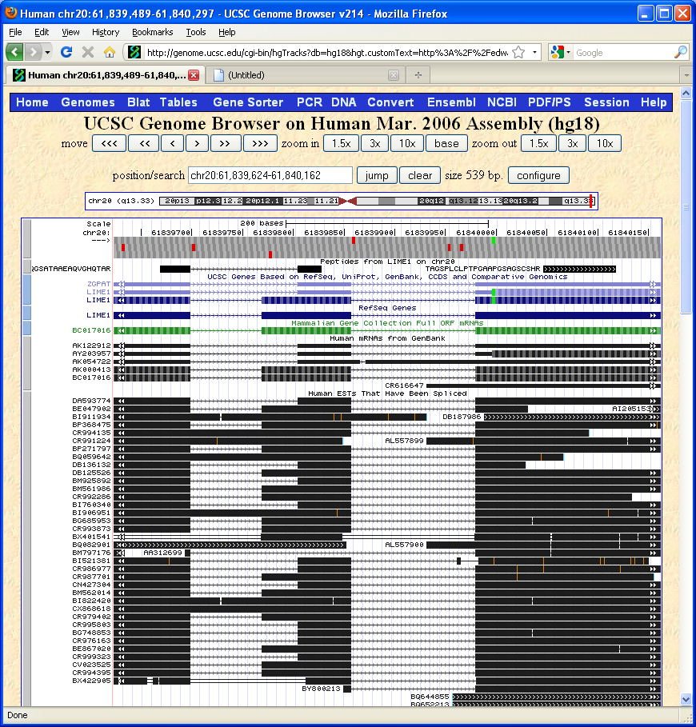
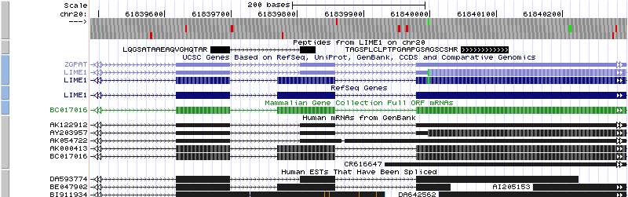
PeptideMapper Web Service
I’m Feeling Lucky

Slide 9
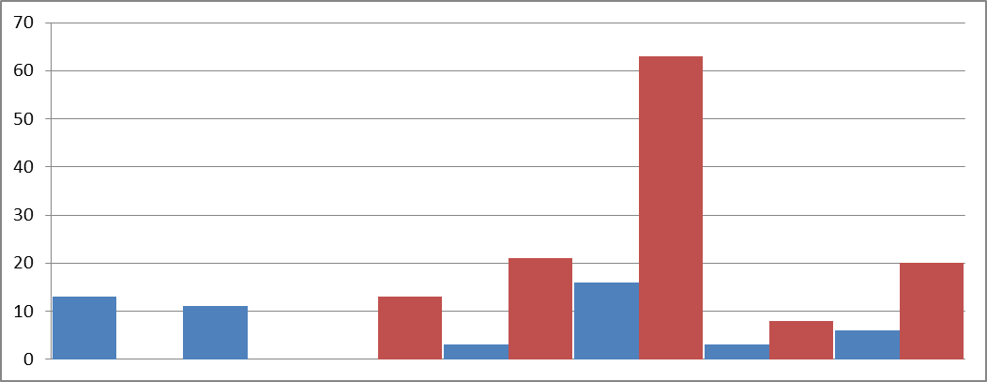
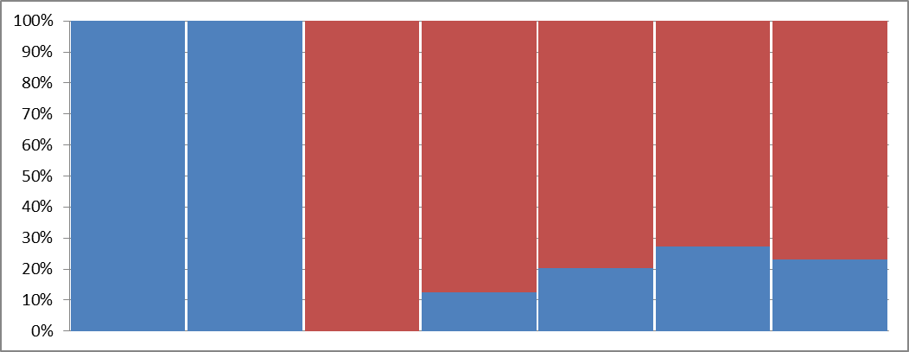
If a tree falls in the forest…

Slide 10
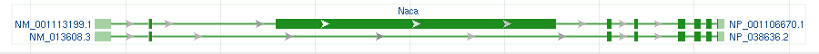
Nascent polypeptide-associated complex subunit alpha
Long form is "muscle-specific"
  Exon 3 is missing from short form
Peptide identifications provide evidence for long form only
  9 peptides are specific to long form
  6 peptides are found in both isoforms
Urn with balls of 15 different colors
  p-value of observed spectral counts: 7.3E-8

Slide 11
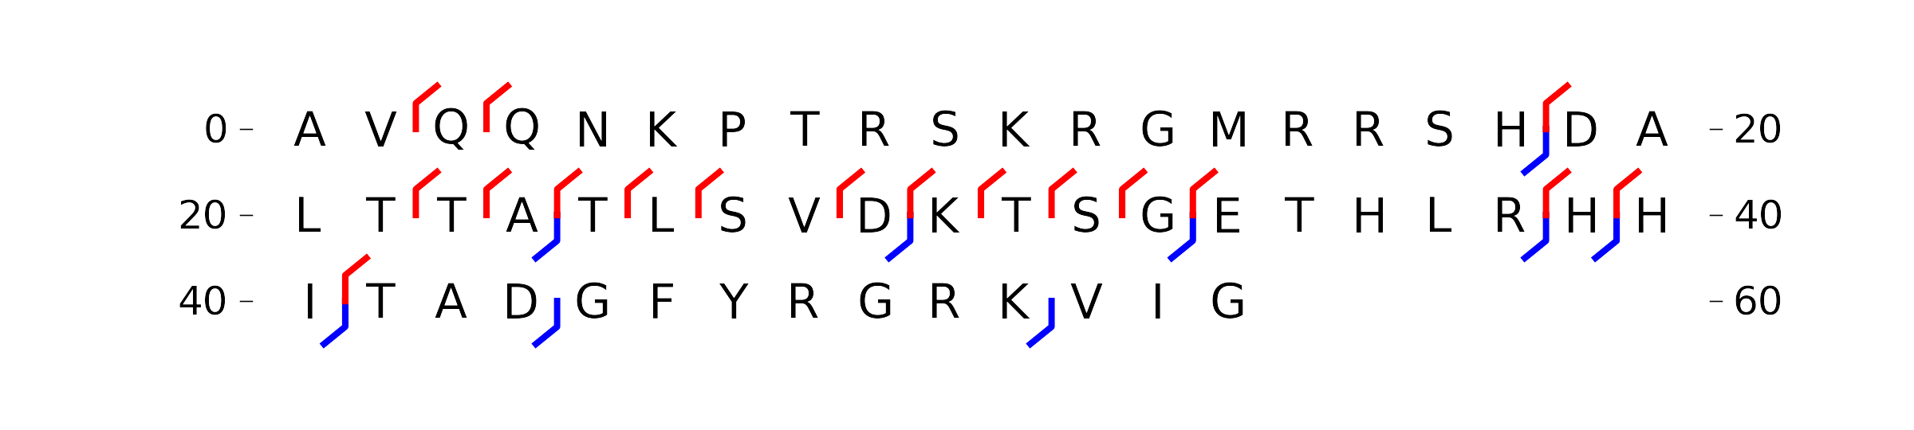
Top-down CID Protein Fragmentation from Y. rohdei
Match to Y. pestis 50S
Ribosomal Protein L32

Slide 12
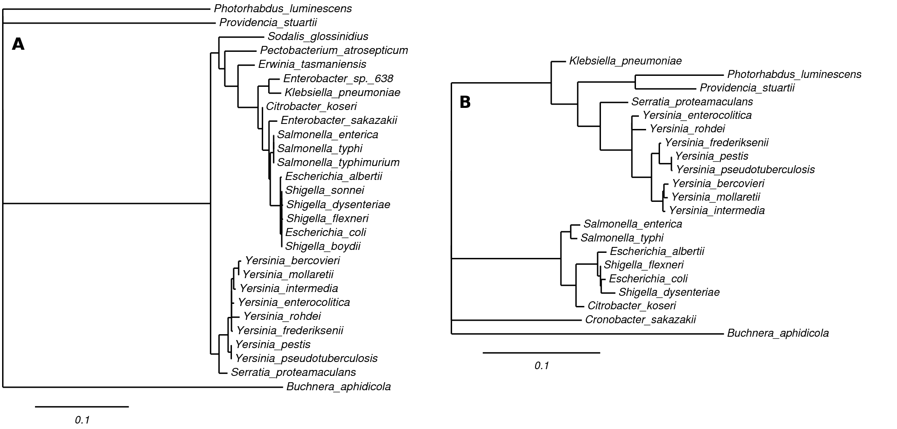
Phyloproteomics of Y. rohdei
Protein Sequence
16S-rRNA Sequence

Slide 13
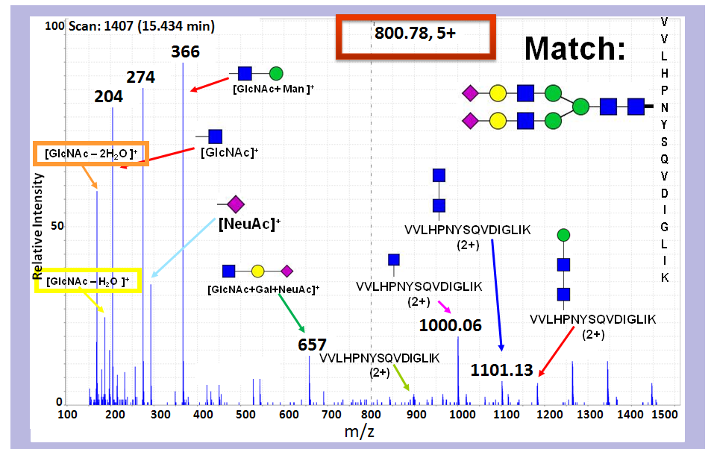
Example Glycopeptide CID Fragmentation Spectrum

Slide 14
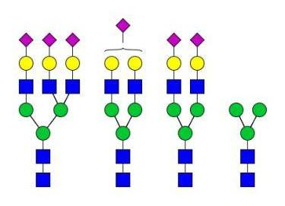
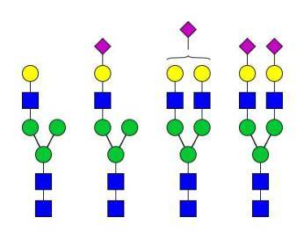
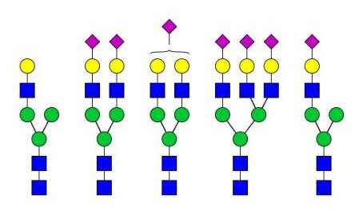
Haptoglobin standard
MVSHHNLTTGATLINE
Haptoglobin (HPT_HUMAN)
NLFLNHSE*NATAK
VVLHPNYSQVDIGLIK
N-glycosylation motif (NX/ST)
* Site of GluC cleavage
Pompach et al. Journal of Proteome Research 11.3 (2012): 1728–1740.

